Slide 1

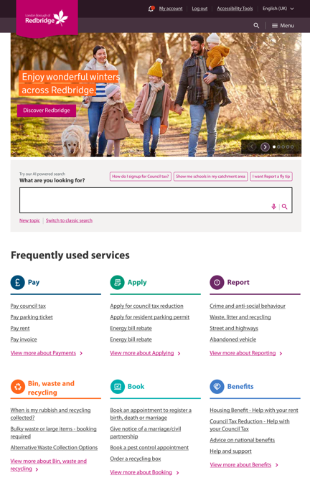
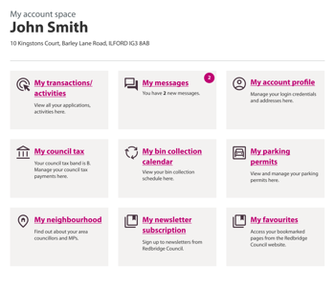
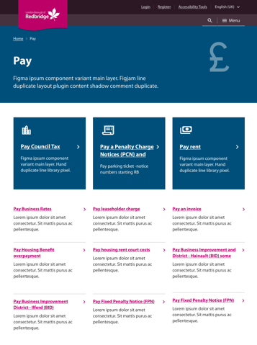
Redesign of Redbridge.gov.uk
User Research Findings
Web & Digital Development Team
August 2024

Slide 2
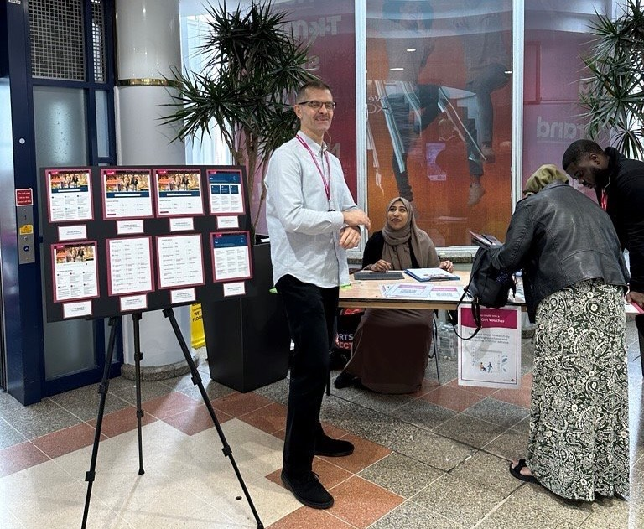
Content
Background
slides 3 – 8
Insights
slides 9 – 19​

Slide 3
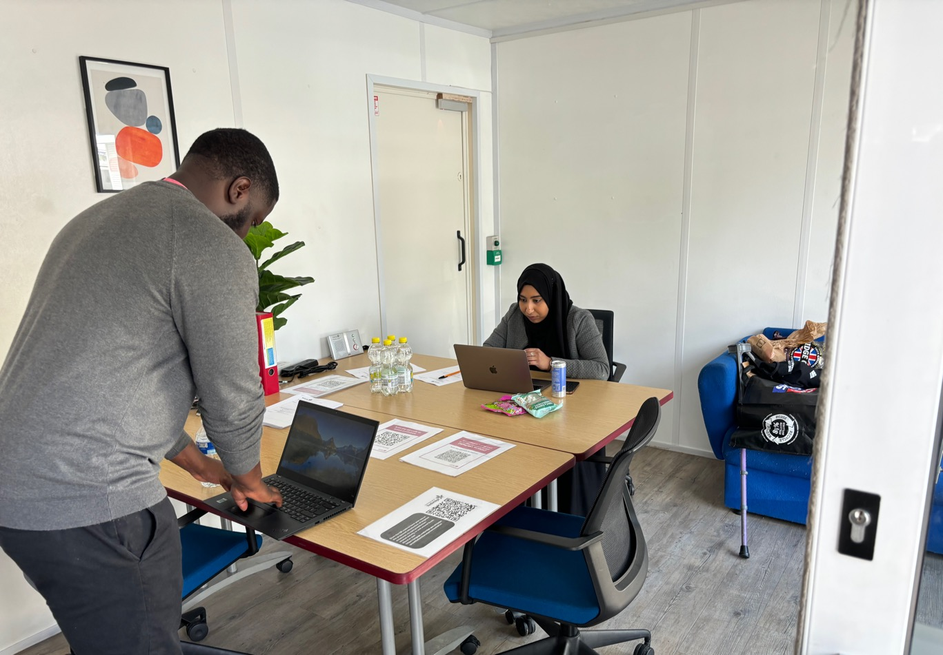
BACKGROUND

Slide 4





The objectives
Understand Resident Usage
Evaluate Current Effectiveness
Gather Feedback on New Designs
Identify Pain Points
Evaluate New Design Usability
Investigate how and why residents use the Redbridge website.
Assess how well the existing website meets the needs of residents.
Collect opinions from Redbridge residents about the proposed design changes.
Pinpoint any issues or challenges users encounter with the current website.
Assess the usability and effectiveness of the new website designs.

Slide 5

What we did
52 Participants in total
We used quantitative and qualitative research methods to understand residents' needs.
Format | Method | Amount of participants | Location
Usability Testing | - One to One - Test Tasks - Questions | 7 | Via Microsoft Teams
Pop-up Session | - Questionnaire - Rapid A/B Testing - Test Tasks | 37 | - Ilford Exchange Mall - Customer Contact Centre - Ilford Engagement Hub
Focus Group | - Questions - Conversation Based | 10 | Redbridge Central Library– Lab Central Tesco Goodmayes-Community Space

Slide 6

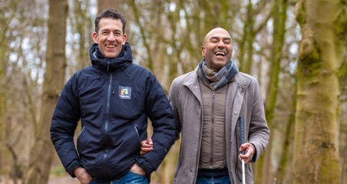

Who we engaged
OLDER RESIDENTS
DIGITAL NATIVES
DISABILITIES
MULTILINGUAL
INCLUDES
Residents who are retired/ have had a job which requires digital skills / volunteers.
KEY DEMOGRAPHICS
- Aged 55+
- Some may have lower digital literacy/not confident with technology
- Residents in employment/ Retired residents/ Residents who are volunteers
NEEDS
- Help navigating certain online services
- Ability to reach the council offline if
there’s an issue
INCLUDES
Students, young working professionals, civil servants, medical professionals.
KEY DEMOGRAPHICS
- Between ages of 20-45
- High digital literacy
- Residents in education/Residents working in a professional capacity
NEEDS
Clear and obvious routes to information
INCLUDES
Users with visual/motor impairments or learning disabilities
KEY DEMOGRAPHICS
- All ages
- Low digital literacy/Low confidence
-Residents who are in employment, education or unemployed
NEEDS
Accessibility adjustments to help them reach desired services.
INCLUDES
Users from ethnic minorities.
KEY DEMOGRAPHICS
- All ages
- Low digital literacy/Not fluent in English
- Residents who are in employment, education or unemployed
NEEDS
Simple and clear English used on the website/ Be able to access the website in different languages.
Note: Further research required to understand better

Slide 7







Our approach
Planned User Research
Recruited users
Organised Research Sessions
Conducted User Research
Present final designs & handover
Iterate design & retest with users
Analysed insights

Slide 8
Questions we asked
Remote one-to-one interviews | Pop-up sessions | Focus Group
On a scale of 1-5, 1 being very hard, 5 being very easy, how would you rate the design of this page? [in terms of layout/colours?] | Have you ever used the Redbridge website? | What are examples of good websites?
Does the order of the page make sense? | What do you like about our new designs? | What do you expect to see on a council website?
Is there anything that you would rearrange? If yes, why? | [Rapid A/B testing] Do you prefer coloured links vs. monochrome links? | What issues would you expect to solve on these websites?
Would you be able to do everything you needed to do on the website? | Do you prefer the design with Links with icons vs. Links without icons? | Are there any aspects of the current design that you would like to see retained in the new design?

Slide 9
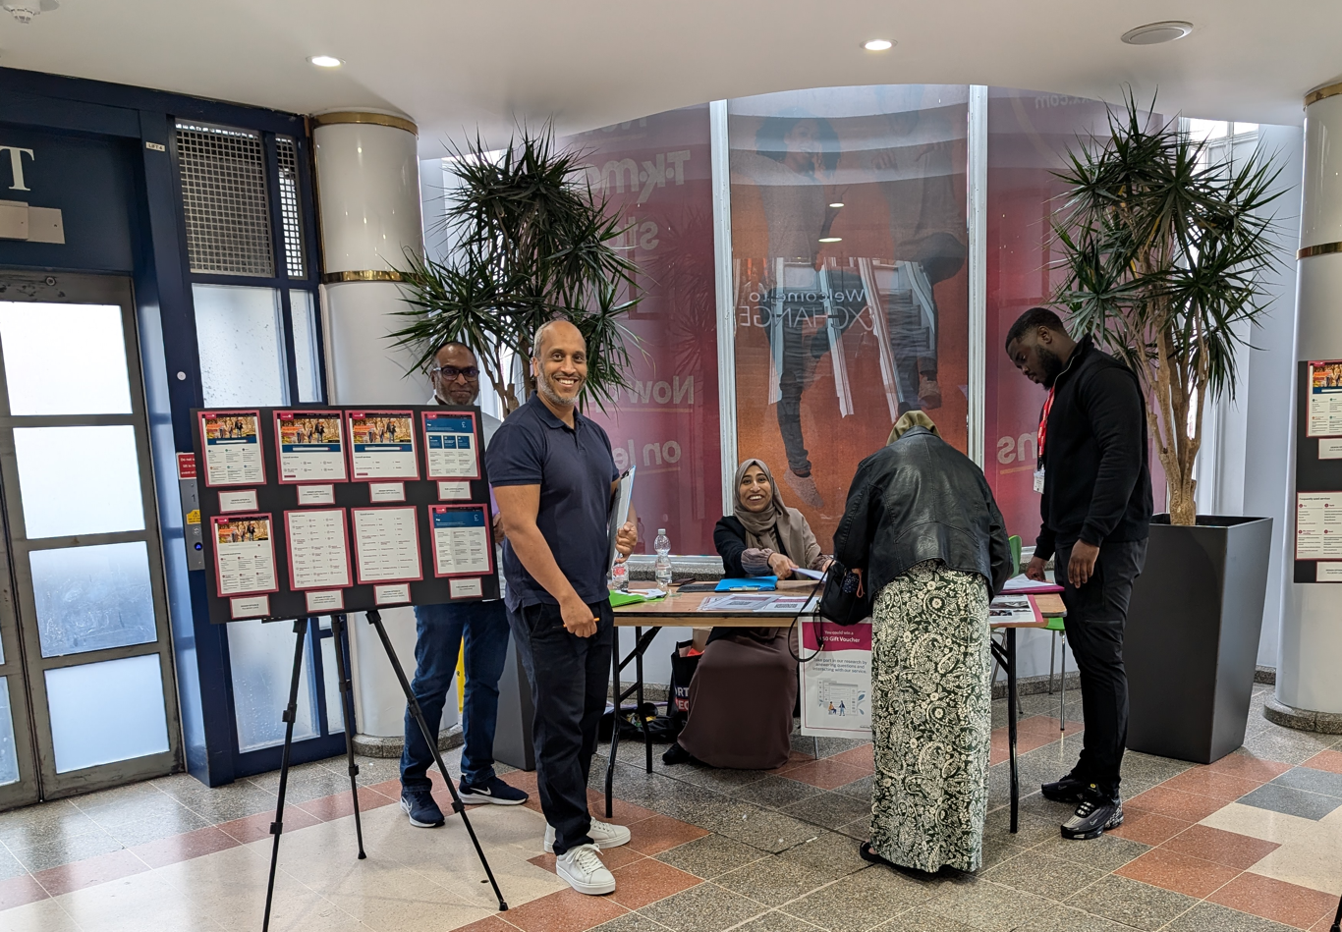
INSIGHTS

Slide 10
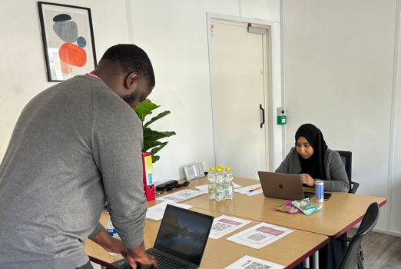
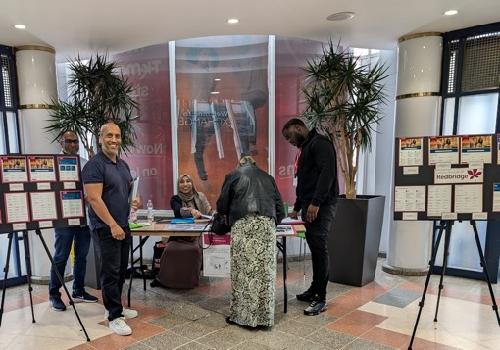
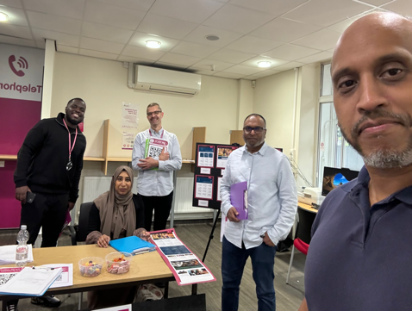
Summary
How our new designs scored
The website scored well in design and navigation, with most users giving it a rating of 4 out of 5 in usability testing
Our focus group found that the new proposed website effectively meets user expectations.
From our Rapid A/B Testing:
80% preferred colour vs monochrome
94% preferred icons vs no icons
62% preferred minimised links vs all links

Slide 11
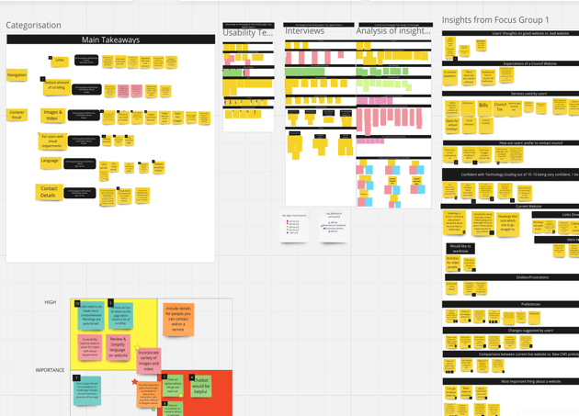
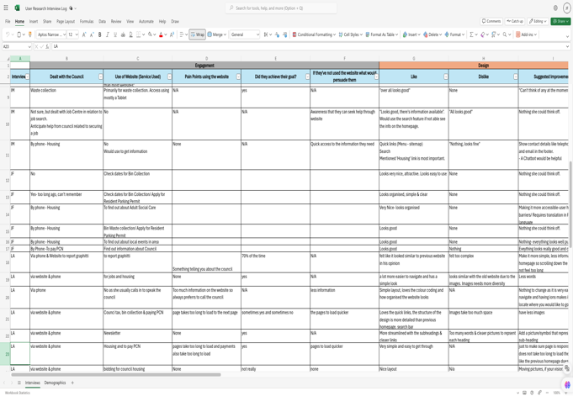
Main takeaways
Resident feedback indicated several areas for improving the new designs:
  [Images, icons & colours] Designs that incorporate both icons and colours for categorisation were well-received.
  [Simple & clear language] For all users - and especially residents with only basic English - using straightforward and clear language makes it easier to navigate the website.
  [Accessibility] Ensuring that the website is WCAG compliant for users with disabilities
  [Navigation]-Link headings to be more descriptive so that users can understand its purpose & functionality clearly
  [Review Page Length] Users would prefer for important information to be located at the top
  [Communication with the council] Many residents expressed a desire to speak directly with council representatives for urgent matters.
(Links to these documents are included in the appendices)

Slide 12


Images, icons & colours
User feedback
“I want to see people that look like me on the website”
"The images make the website feel welcoming—"they give me a positive impression of Redbridge."
"The coloured icons are memorable—'next time I visit, I'll remember it was the orange one."
Users' preferences for images, icons & colours
Users liked images on website- would like to see more diverse range of images.
Users preferred design options with colours over monochrome designs.
Improvements
Diverse Imagery: The images across the website – including the ‘Hero’ image - should represent the diverse community of Redbridge

Slide 13
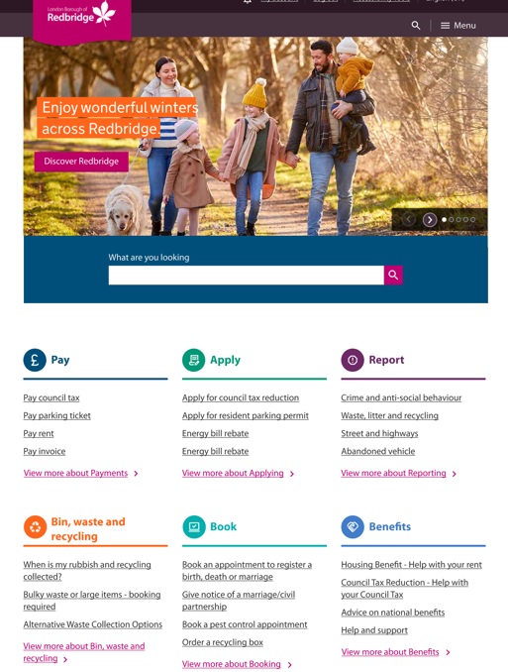
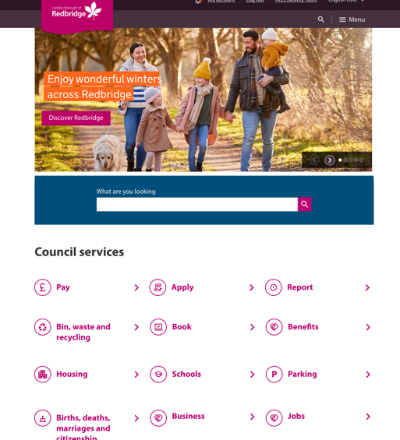
Images, icons & colours (cont.)
User feedback
“Prefer different colours as Mulberry links might get mixed up”
”Icons helps people whose first language is not English”
“Don’t know much about computers-this way easier to find relevant services”
User preferences
From our Rapid A/B Testing, these were the results:
80% preferred colours vs monochrome
94% preferred icons vs no icons
62% preferred minimised links vs all links
Improvements
Incorporate colours on the homepage
Choose a set of icons which is easily identifiable

Slide 14
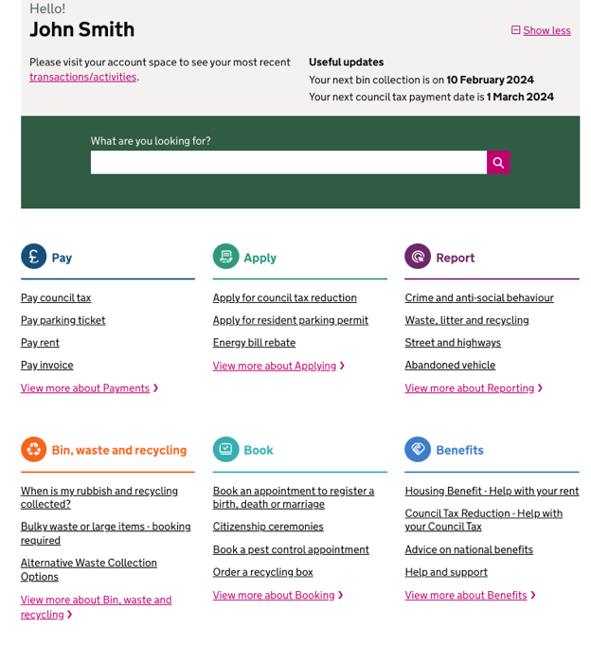
Simple & clear language
User feedback
”Book-what does that mean? Clearer sub-headings needed"
"Felt too complex"
"Too many words"
Review words/language used on website
Users suggested that simple, clear English language would help them use the website. Sometimes things are not clear, particularly for Multi-lingual residents
Improvements
Revise wording and language used on the website to help residents navigate more easily
Using simple and clear English to help multi-lingual residents navigate the website

Slide 15
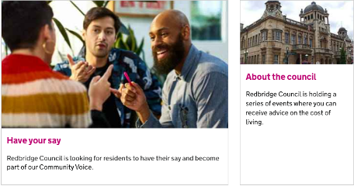
Accessibility
User feedback
“...if your vision is impaired, have an option where things are read out."
"Font size should be bigger as user has visual impairment."
Ensure that website is WCAG compliant
Users with disabilities can access and navigate the website
Understand users' needs further
More user research required to understand users’ needs better
Improvements
Ensure that the website is accessible and compliant to WCAG guidelines to ensure that users with disabilities can use the website

Slide 16
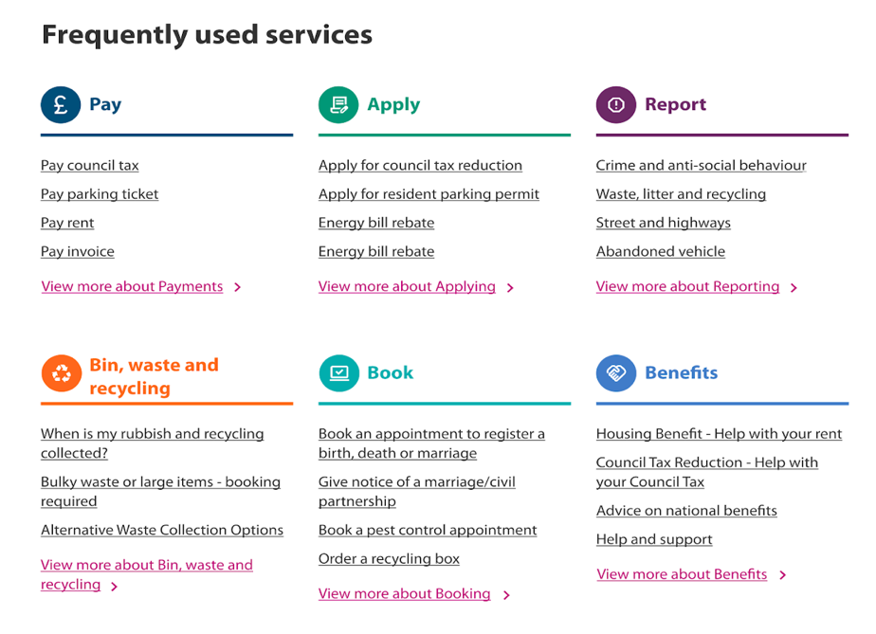
Navigation
User feedback
“Love the quick links.”
"More streamlined with the sub-headings and clearer links"
Categorisation of links
Users appreciated the categorisation of links, which enabled them to access services more quickly.
Improvements
"Some of the options are under the wrong menu items.” “’Book’ doesn’t explain what it is"
Link titles should be descriptive
Headings need to be more descriptive to ensure residents can easily understand and navigate the categories.

Slide 17
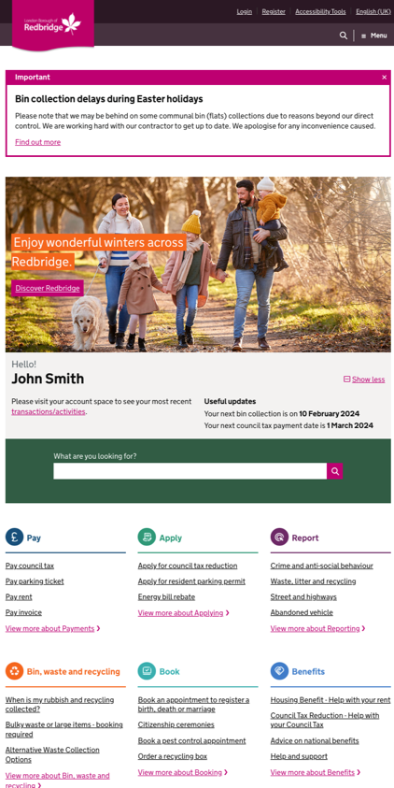
Review page length
User feedback
"Make it more simple, less information on the homepage so scrolling down the page does not feel too long”
"Only when I saw the image, did I decide to scroll down further"
List of Services
The list of services is positioned quite far down the page, requiring excessive scrolling.
Quick Links Visibility
Residents would like ‘Quick Links’ to be prominently visible as soon as they open the website.
Page Length
The page is considered long. A suggestion from some users is to resize the ‘hero’ image so important links can appear higher on the page.
Improvements
Move Services Higher: Relocate the services section closer to the top of the page to minimize the need for scrolling.
Pin Quick Links to the Top: Ensure that the 'Quick Links' section is prominently placed near the top of the page.
Resize Hero Image: Reduce the size of the hero image to bring key content, including services and quick links, further up on the page.

Slide 18
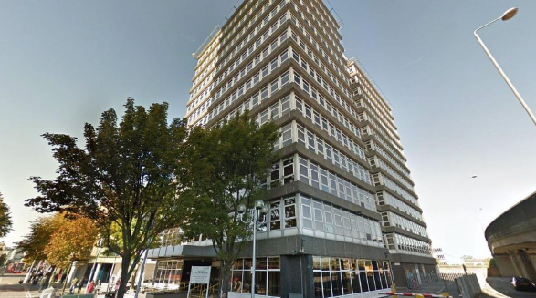
Communication with the Council
User feedback
“I have an eviction notice. I want to send it to the Housing Manager”
"Show contact details like telephone numbers and email in the footer."
Direct communication
Residents expressed frustration in making direct contact with particular people or services – especially on ‘urgent’ matters
People worry that elderly residents and Non-English-speaking residents can't get to the help they need.
Improvements
Guide users - to address urgent issues
Find efficient ways to get elderly and Non-English-speaking residents to the information or hekp they need

Slide 19
Challenges & solutions
Challenges/suggestions | Possible solutions
The Quicklinks section is popular but needs to cover the most useful/popular content and be very clear and understandable. | Clear descriptions for headings and links. Careful selection of content to include – possibly based on usage stats.
Users commented that some information was a long way down the page. | Think about the length of page, resizing elements to reduce page length, putting the most important things at the top.
Users want simple and clear English language to be used on the website. Sometimes things are not clear, particularly for Multi-lingual residents | Revise wording and language used on the website to help residents navigate more easily [crossover with work being carried out by CDL].
Ensure the website is WCAG compliant for users with disabilities | Ensure users with disabilities can navigate with their own software/devices. ReciteMe tool. More user research.
Users expressed that a more diverse Hero Image would better suit the website | Use regularly-changing imagery that reflects the diversity of the borough
Integrate a feature which helps residents find links quicker | Ensure that we continue to have an effective efficient search capability. Continue prototyping of our AI Search.

